Slide 1


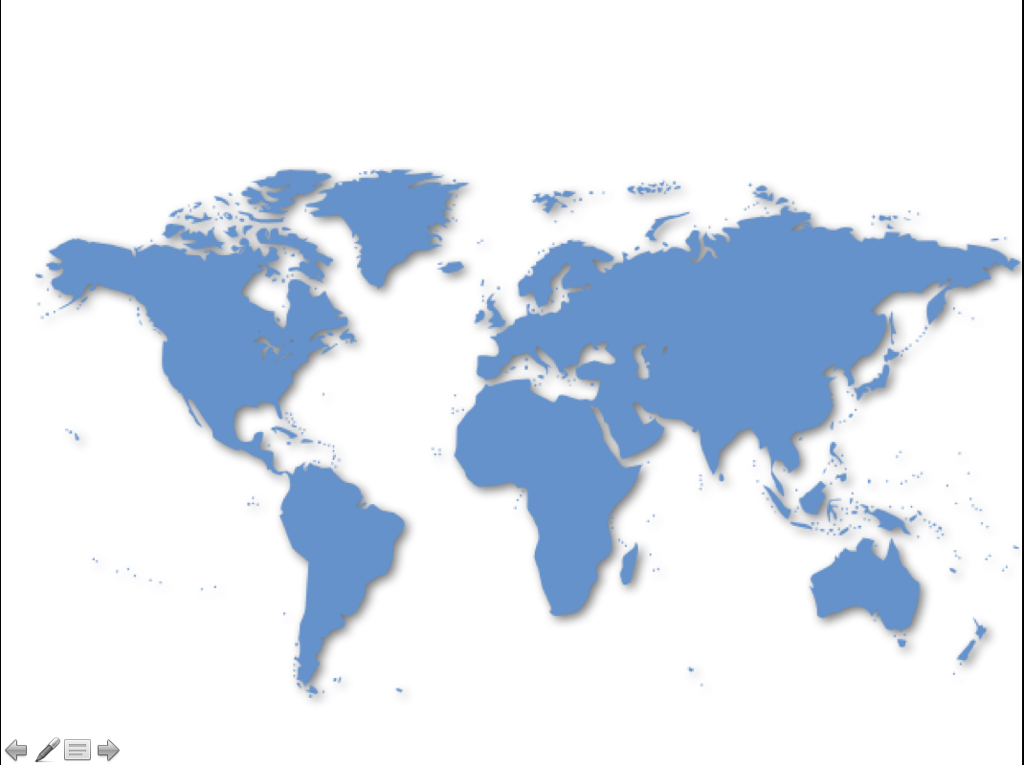





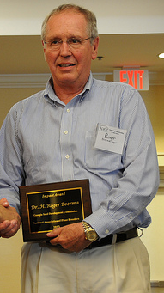

Academic History
Syracuse, NY
Biotechnology BS
Vienna, Austria
Athens, GA
Ithaca, NY
The University of Georgia®
Institute for Plant Breeding, Genetics & Genomics
Los Baños, Philippines
Google images

Slide 2




What You Know as Rust
Images: corbis.com

Slide 3
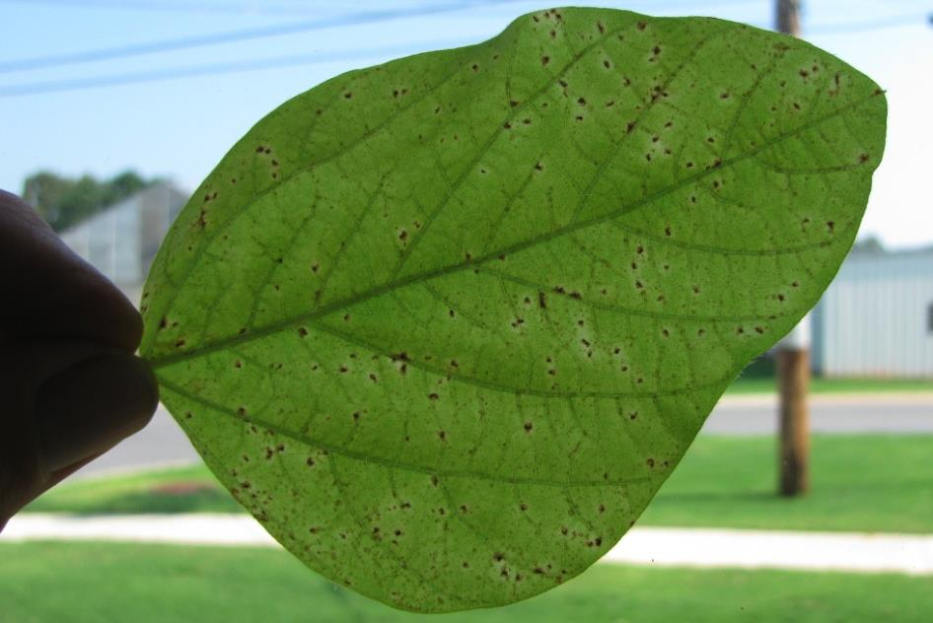
Fighting Rusty Beans with Putatively New Green Genes
The University of Georgia®
Institute of Plant Breeding, Genetics & Genomics
Zachary King, United Soybean Board Fellow

Slide 4
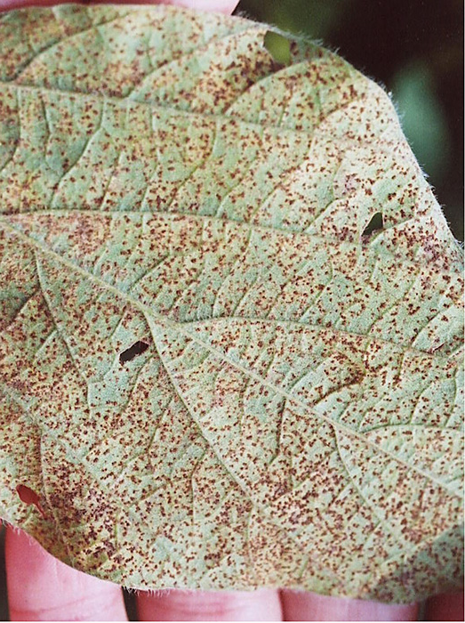
Panic: 2001 Rust Hits South American Soybeans
Paraguay 2001
Brazil 2001-2002
60% of acreage
0.1 million metric tons
Brazil 2003
>90% Brazil fields
>$487 million
80% of soybeans
Sprayed 2X
$544 million
Image: Aspnet.org
Yorinori et al., 2005. Plant Disease 89:675-677.

Slide 5
The Global Invasion
2004
1971
1902
1994
1998
1970
1966
1913
1914
2004
1975
1984
1996
1966
2001
1961
1998
2001
1934
2001
Map: Google Images
Invasion points based on image by kcp4911 via flickr

Slide 6
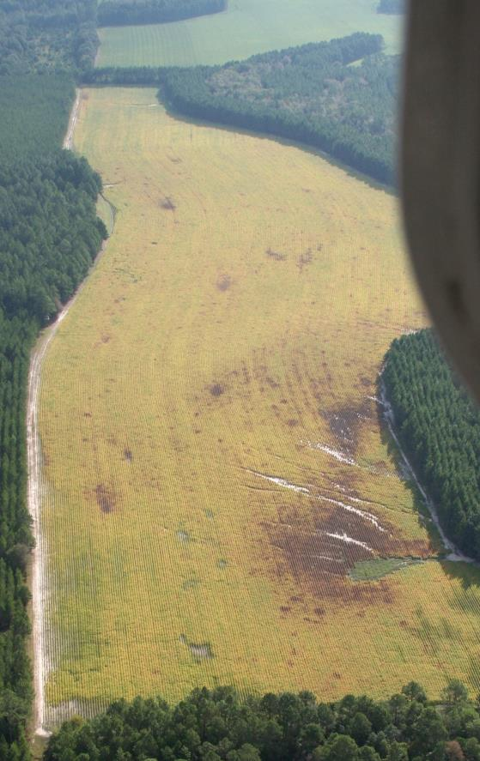
Most Destructive Foliar Disease of Soybean
14 day, asexual life cycle
Yield loss potential
70%
Filled pods and seeds
Seed weight
Lower oil
Phakopsora pachyrhizi
Basidiomycete
Obligate pathogen
Ogle et al., 1979. Aust. J. Agric. Res. 30:883-893.
Bromfield 1984. Monograph no. 11. American Phytopathological Society
Jeff Davis County in 2009 Photo: Tim Varnedore

Slide 7
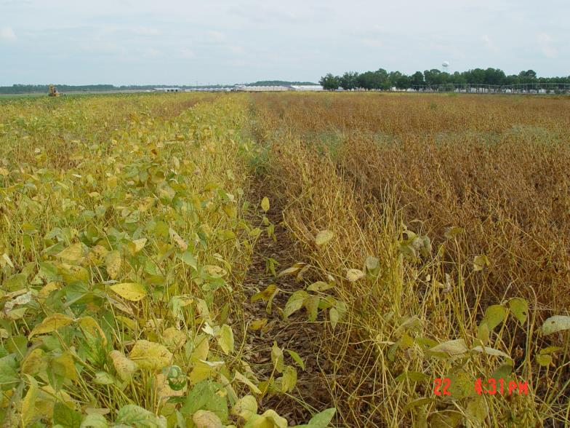
Most Destructive Foliar Disease of Soybean
Fungicide
No fungicide
Sunbelt Ag Expo. 2006 Photo: Bob Kemerait

Slide 8
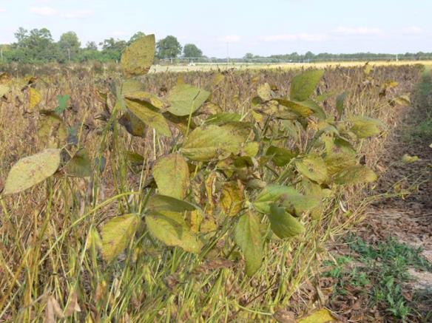
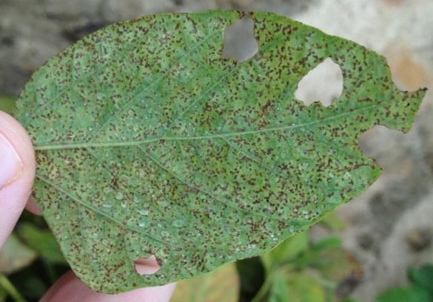
Disease Symptoms
Premature defoliation
Yellowing of leaves
Lesions
Favorable conditions
Rain, dew periods, 15-29°C
Image: David Walker

Slide 9
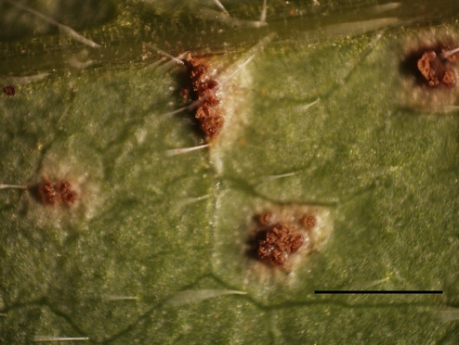
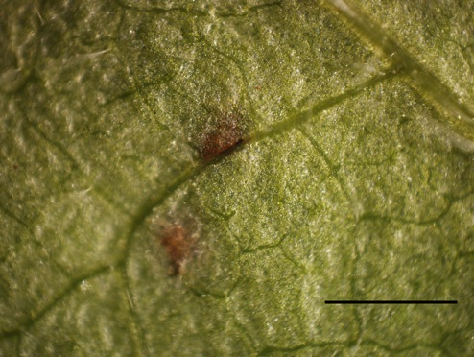
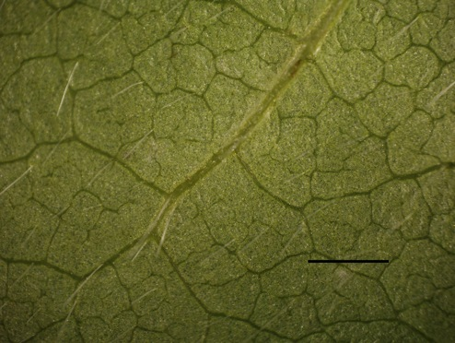
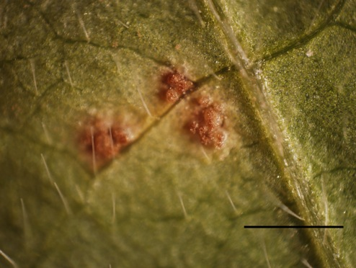
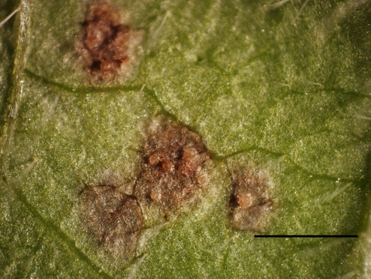
Disease Signs
TAN
Susceptible lesion
Red Brown (RB) Resistance lesion
Immune (IM)
Bar = 1 mm

Slide 10
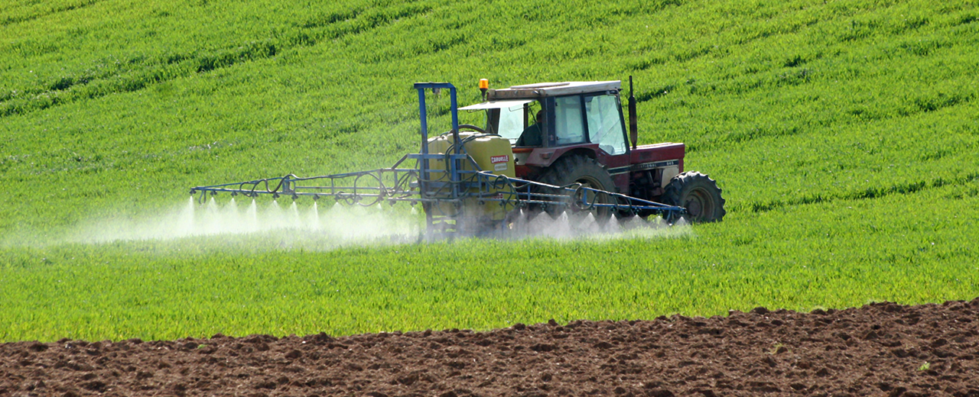
Resistance Genes are Green
Environmentally safe/Fungicide free
Fuel/Cost/Emissions
Broad spectrum
Time
Problem: No resistant varieties deployed in the USA, even in 2012
Image: cheminova-us.com

Slide 11
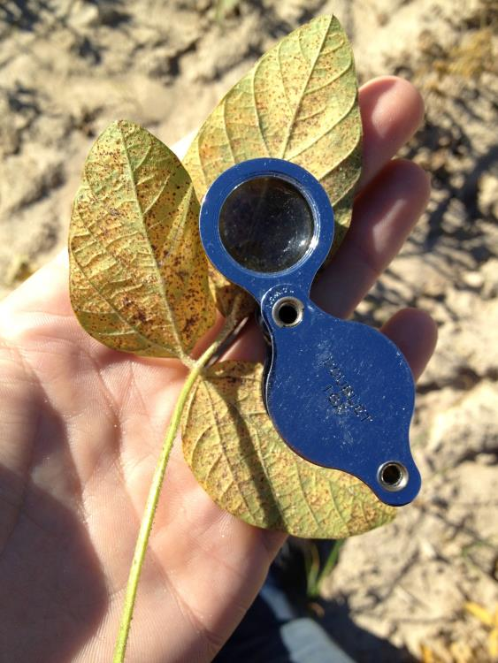
Fighting Rusty Beans with Rpp6
Rpp6 as a key gene for the southeastern USA
Fine mapping the Rpp6 gene
Rpp6 for the future of SE USA agriculture

Slide 12
Available and Mapped Rpp Genes
1
2
3
4
5
6
7
8
9
10
11
12
13
14
15
16
17
18
19
20
Mb V2.0
-0
Rpp6
-10
-20
Rpp2
rpp2
-30
Rpp5
rpp5
-40
Rpp3
Rpp?(Hyuuga)
Rpp4
-50
10 Mb
Rpp1
Rpp1-b
-60
Template contributed by Nathan Hancock
and modified by Zachary King
Li et al., 2012 Theoretical Applied Genetics doi:10.1007/s00122-012-1821-y; Garcia et al., 2008. Theoretical Applied Genetics 117:545-553.; Hartwig and Bromfield, 1983. Crop Science 23:237-239.; Hartwig, 1986. Crop Science. 26:1135-1136.; Hyten et al., 2007. Crop Science 47:837-840.; Hyten et al., 2009. Crop Science 49:265-271.

Slide 13
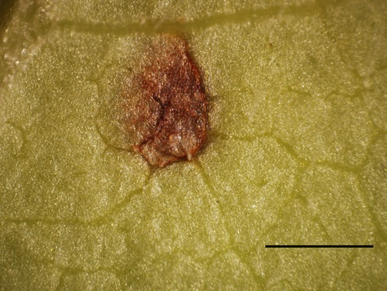
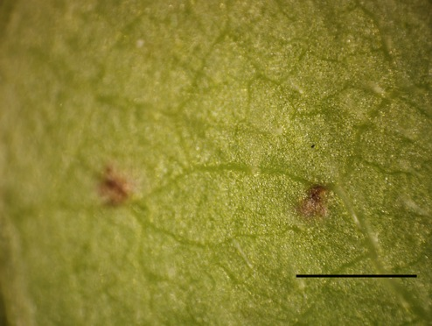
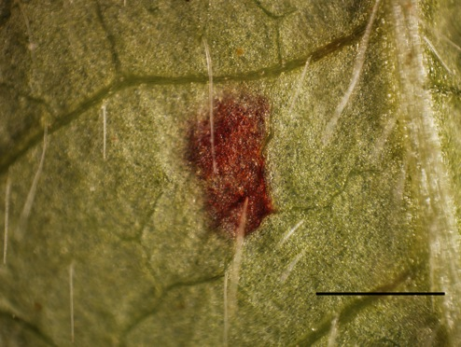
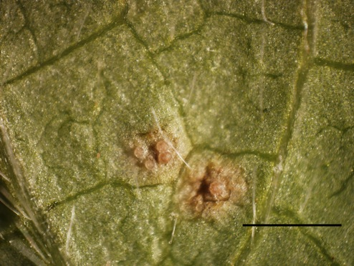
PI200492 (Rpp1)
PI230970 (Rpp2)
PI462312 (Rpp3)
PI459025A (Rpp4)
PI506764‘Hyuuga’(Rpp3+Rpp5)
PI200526 (Rpp5)
PI567102B (Rpp6)
Prichard (Susceptible)
G00-3880 (Susceptible)
Bar = 1 mm

Slide 14

Using Rpp6 in the Southeast
PI567102B (Rpp6)
Bar = 1 mm
P1 x P2
G00-3213
Rpp6 Donor
G00-3213 x F₁
PI567102B
Rpp6 Donor
Red-brown resistance
BC₁F₁ Selected x P1
Susceptible
5 x
BC₆F₁ Selected x P1
⊗
BC₆F_{2:3}
Select Best
G00-3213
High-yielding
TAN susceptible

Slide 15
Super Bulk Segregant Analysis and Dominant Genes 1:2:1 Ratio
G00-3213 Elite
Susceptible
PI567102B Rpp6
Resistant
P1 x P2
S-Bulk x35 families-420 plants
R-Bulk x35 families-420 plants
F₁
⊗
F₂
⊗
140 F_{2:3}

Slide 16
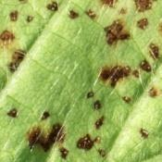
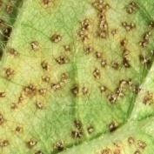
Bulk Segregant Analysis
R-Parent
S-Parent
R-Bulk x12
S-Bulk x12
Super bulks F2:3
Bulks F2
Co-dominant marker is linked to rust resistance gene
Images: Mandy Kendrick

Slide 17
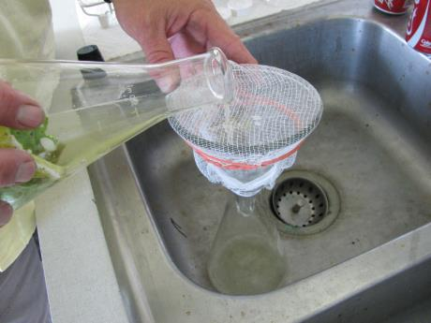
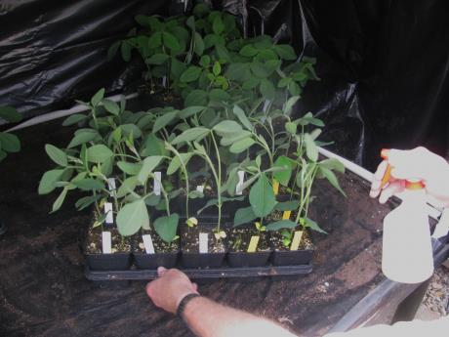
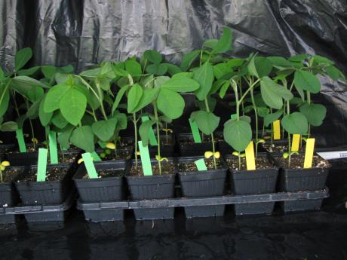
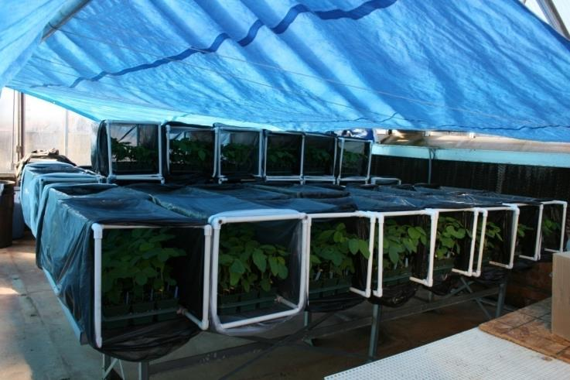
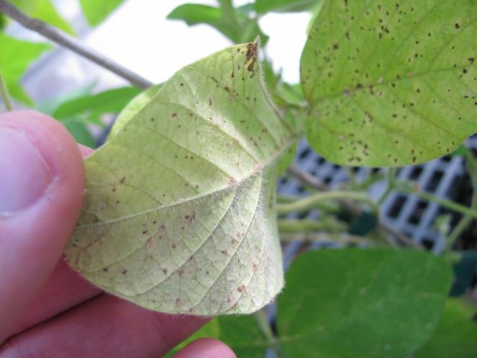
Inoculation for Phenotyping
Griffin, GA Photos: Donna Harris and Zach King

Slide 18
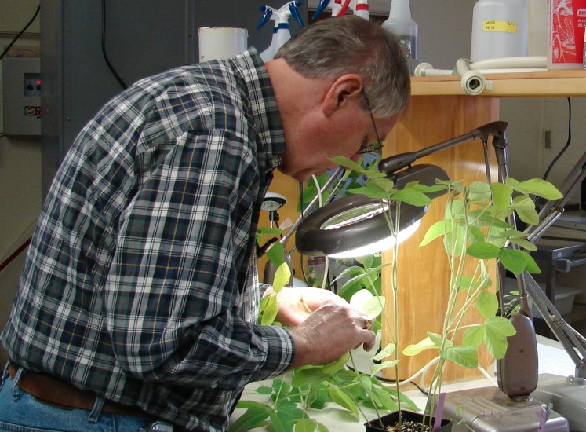
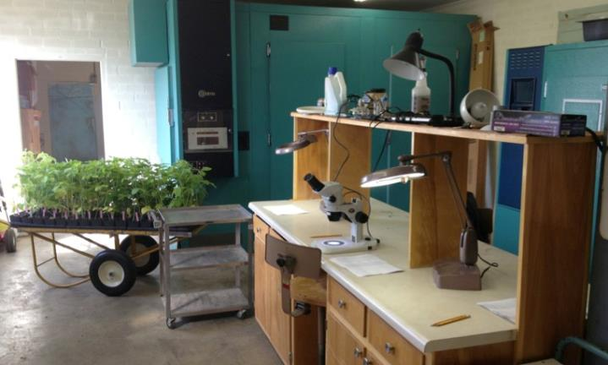
Phenotyping Process in Greenhouse
Observations
Using several leaflets
1st or 2nd trifoliolate
Lesion type (RB/IM/TAN)
Sporulation
Slide images by Roger Boerma and Zach King

Slide 19
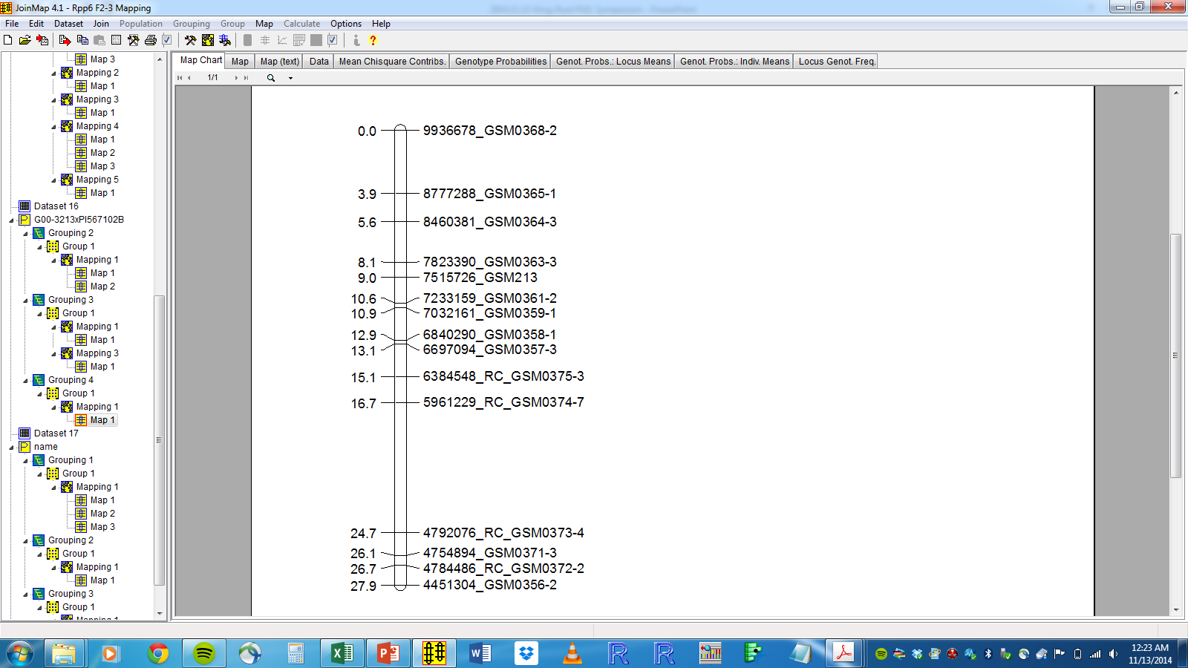
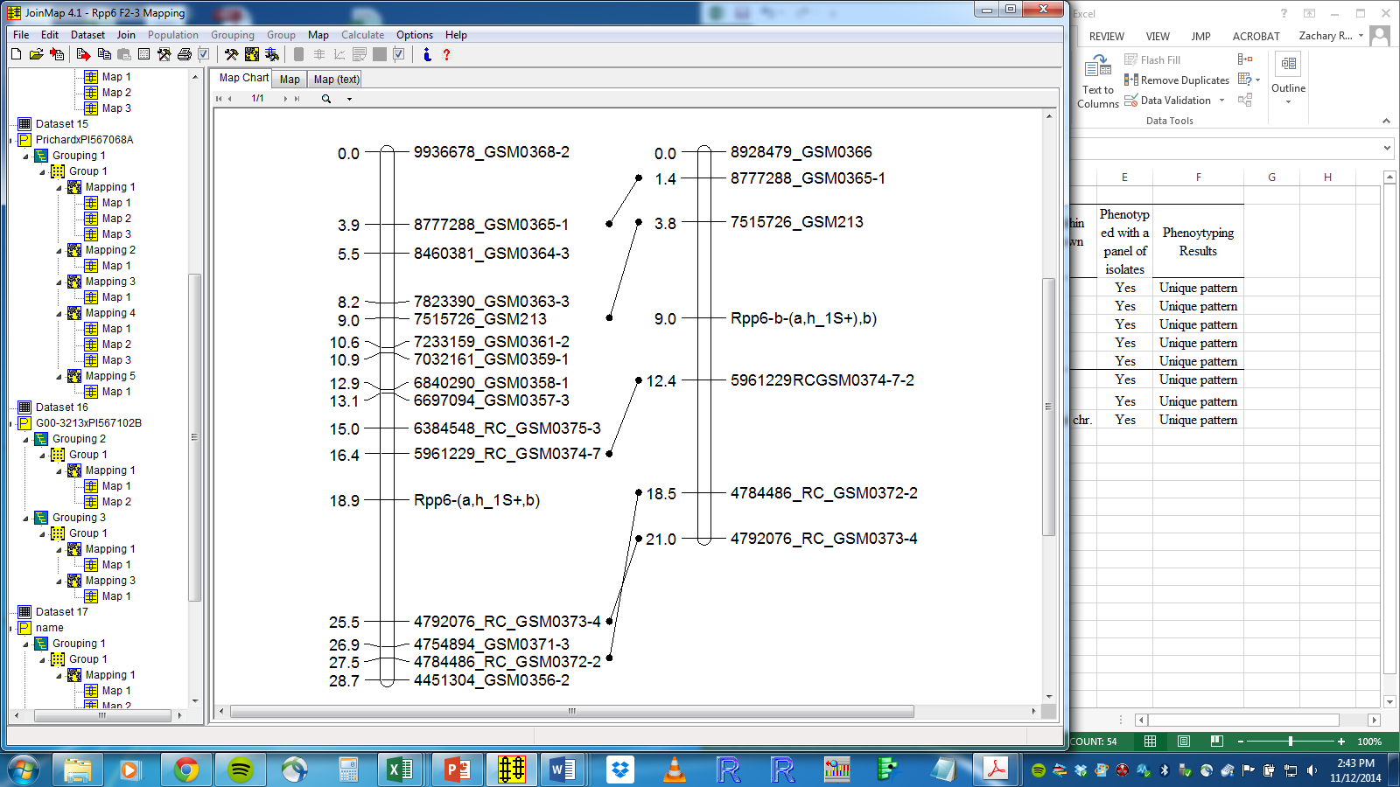
PI 567102B (Rpp6) Fine Mapping
Map units
DNA bp
18
Rpp6
Map units
DNA bp
5.49 Mbp
?
1.17 Mbp
21%
10M bp
JoinMap 4.1

Slide 20
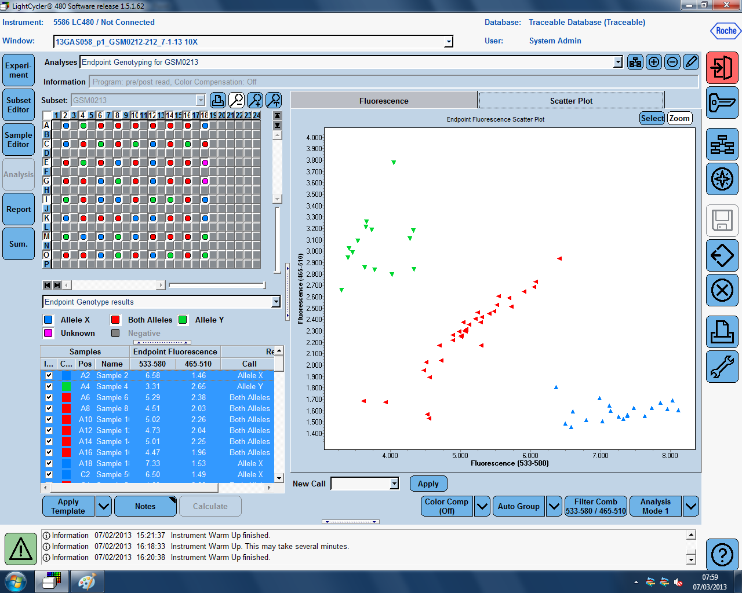
SNP Marker GSM0213 Star linked to Rpp6 resistance
1:2:1 Genotypically and phenotypically (F2:3)
$$$
25 cents
vs. $5-10
[C/C]
[T/C]
FAM Intensity
[T/T]
VIC Intensity

Slide 21
Conclusions
Rpp6 is a valuable trait for the SE USA
Capable of conferring RB resistance
SNPs are inexpensive to use for selection
25 cents vs. $5-10
Save time and can tell zygosity
SNPs allow us to pyramid R-genes
Not possible reasonably with selection
DNA marker GSM0374
Works excellently for selection of Rpp6
Further work will be identifying Rpp6
Functional marker
Eliminate or reduce fungicides in SE USA

Slide 22
Fighting Rusty Beans with NILs
NILs as a key tool for public, and private breeding sectors and to identify changes in fungal populations
Marker assisted backcrossing
Field assessment and release of germplasm

Slide 23
Backcross NILs of G00-3213
1
2
3
4
5
6
7
8
9
10
11
12
13
14
15
16
17
18
19
20
Mb V2.0
-0
P1 x P2
Rpp6
G00-3213
Donor
-10
G00-3213 x F₁
-20
BC₁F₁ Selected x P1
Rpp2
-30
3-5 x
Rpp5
BC₄₋₆F₁ Select Best
-40
⊗
Rpp3
Rpp?(Hyuuga)
-50
BC₄₋₆F_{2:3}
Select Best
Rpp4
10 Mb
Rpp1
Rpp1-b
-60
Template contributed by Nathan Hancock
and modified by Zachary King

Slide 24
Backcrosses to G00-3213 for Potential Germplasm Releases
Confirmed Gene | Plant Introduction | Selected with Resistance and or SNP Markers | Status
Rpp1 | L85-2378 | Yes/Both | BC₆F_{2:3}
Rpp1-b | PI 594538A | Will Select with SNP Marker(s) | F₂; BC₁F₁ Greenhouse
Rpp2 | PI 230970 | Yes/Both | BC₆F_{2:3}
Rpp3 | PI 462312 | Yes/Both | BC₆F_{2:3}
Rpp?’Hyuuga’ | PI506764‘Hyuuga’ | Yes (Marker for Rpp3 not Rpp5) | BC₆F_{2:3}
Rpp4 | PI 459025B | Yes/Both | BC₆F_{2:3}
Rpp5 | PI 200487 | Yes/SNP Marker Only | BC₄F_{2:3}
Rpp6 | PI 567102B | Yes/Both SNP GSM213 Gm_7,515,726 | BC₂ F₁; BC₃F₁
Those in red will not be completed during my dissertation, but are an extra effort to provide additional rust resistance resources. We should add the source of rpp2 PI224270 which was Immune/RB in Griffin greenhouse. I am not sure about PI 200456 (rpp5).

Slide 25
Germplasm Release of NILs
G00-3213
G00-3213Rpp1
G00-3213Rpp2
G00-3213Rpp3
G00-3213Rpp4
Bar = 1 mm

Slide 26
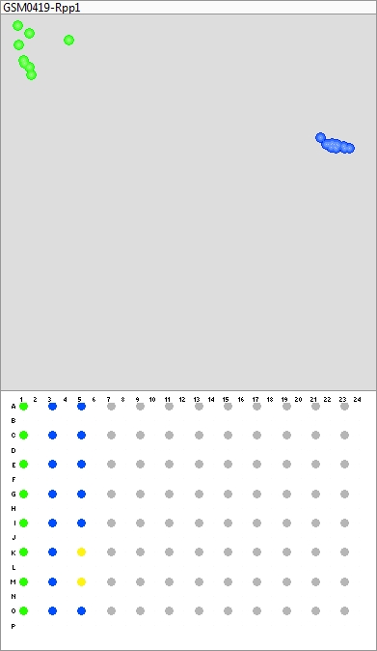
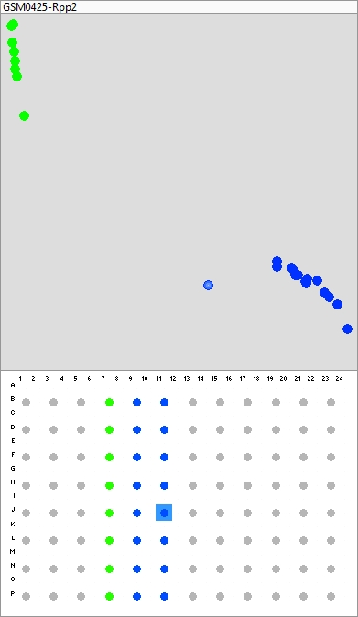
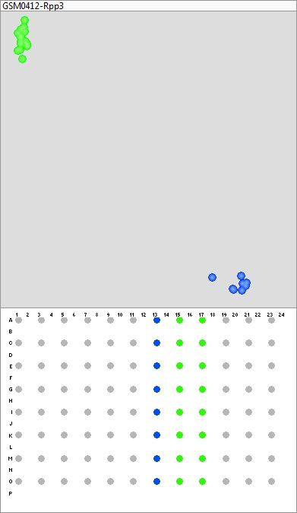
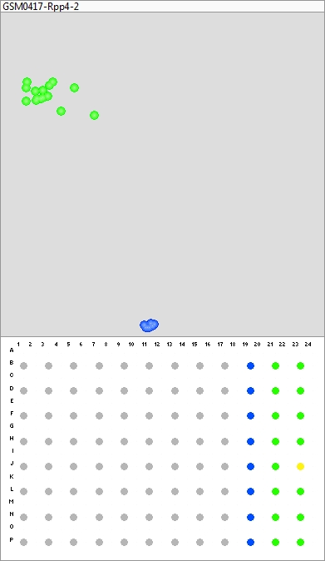
Tightly Linked Breeder Friendly KASP SNP Markers
Susceptible
Susceptible
Rpp1
Rpp2
Rpp3
Rpp4
Susceptible
Susceptible

Slide 27
Fighting Rusty Beans with New Genes
New genes as a key tool for breeding in the public and private sectors
Fighting an ever evolving pathogen
Mapping and assessment of new Rpp genes

Slide 28
Identification of Putative Resistance Sources to Date
110 unique mapping populations screened
Susceptible cultivar x resistant plant introduction
56% Rpp3, over a dozen Rpp6
Collaborating to phenotype PIs
Use of USDA rust isolate panel
Putative new resistance genes
3.5% of plant introductions
10-15 years ago… a lifetime of work

Slide 29
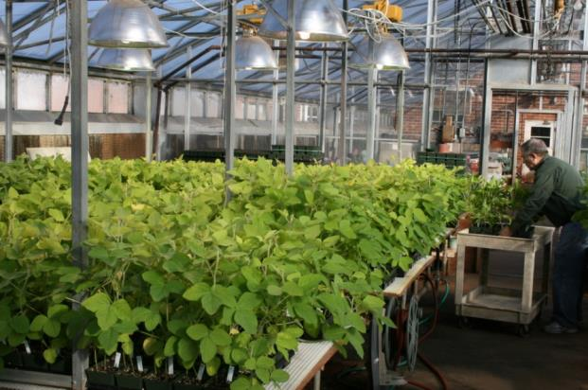
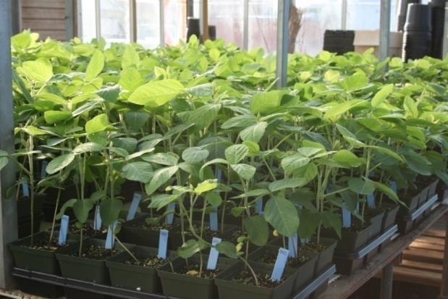
Identifying Novel Rpp Loci: “Champions”
110 crosses
2006 – 2014
Susceptible x resistant
240 F₂ plants
14 dpi phenotype
Bulk segregant analysis
Griffin, GA Photos: Donna Harris

Slide 30
Rpp Gene Mapping Timeline
Grow F2 Population
Plant Sciences Farm
Harvest F2:3 Populations
Plant Science Farm
Grow 140 families of F2:3 population
Griffin Greenhouse
Make cross Plant Sciences Farm
Summer Y1
Winter Y1
Summer Y2
Fall Y2
Winter Y2
Grow F1
Athens Greenhouse
240 F2 Seed for Bulks
Griffin Greenhouse
Send bulks to USDA-ARS
50,000 SNPs
SNPs for MAS
Slide composed with Donna Harris

Slide 31
Isolates Used to Screen US Germplasm
GA 2008-1
HW 1998-1
TW 1972-1
LA 2004-1
LA 2004-3
IN 1973-1
CO 2004-2
ZM 2001-1
AU79-1
SA 2001-1
Map: Google Images

Slide 32
Differential Isolate Data for New Alleles
Rust isolate pannel
Germplasm | CO04-2 | HW98-1 | IN73-1 | LA04-1 | SA01-1 | TW72-1 | ZM01-1 | AU79-1 | LA04-3 | GA
Williams82 | TAN | TAN | TAN | TAN | TAN | TAN | TAN | TAN | TAN | TAN
PI 459025B (Rpp4) | RB | RB | RB | RB | RB | RB | RB§ | RB | RB | RB
PI Rpp4-b | RB | RB | TAN₺ | RB | RB | Mixed | RB | RB | RB | RB
PI 567102B (Rpp6) | RB | RB | RB | RB | RB | Mixed | RB | RB | RB | RB
PI Rpp6-b | m | RB | m | RB | TAN | TAN^{ǂ} | TAN | TAN | RB | RB
§One TAN plant in the first replication.
^{ǂ}One plant in the second replication had a mixed reaction.
₺Only two plants were rated. m is missing. Mixed is when plants had both red-brown and TAN lesions on the same plant. RB is red-brown resistant. TAN is susceptible and sporulating lesion. Isolates locations: CO = Colombia, HW = Hawaii, IN = India, LA = Louisiana, SA = South Africa, TW = Taiwan, ZM = Zimbabwe, AU = Australia, GA = Griffin GA

Slide 33
Haplotype SNP Data
Rpp4 fine mapped interval
SNP ID | ss715631693 | ss715631698 | ss715631699 | ss715631701 | ss715631702 | ss715631707 | ss715631709 | ss715631712 | ss715631715
Gmax_275_v2.0.softmasked | Gm18_51440451 | Gm18_51523215 | Gm18_51528212 | Gm18_51548830 | Gm18_51550715 | Gm18_51584617 | Gm18_51591189 | Gm18_51600256 | Gm18_51640471
PI459025B (Rpp4 Check) | C | T | G | G | C | C | C | T | A
PI Rpp4-b | C | T | G | G | T | C | T | C | A

Slide 34
PI Rpp6-b and PI 567102B (Rpp6) Fine Mapping
PI 567102B (Rpp6)
PI Rpp6-b

Slide 35
PI Rpp4-b vs. PI459025B (Rpp4) Summary Glyma1.01 Identities
PI459025B (Rpp4) vs. PI Rpp4-b
Genomic locations
Gm18: 55,715,639 - 55,913,511 (Rpp4)
Gm18: 52,979,027 - 54,599,614 (Rpp4-b)
Differential isolates Rpp4 vs. Rpp4-b
IN73-1, and TW72-1
DNA extracted, SNP markers made and run on population
Need to make map

Slide 36
PI Rpp6-b vs. PI567102B Rpp6 Summary Glyma1.01 Identities
PI Rpp6-b vs. PI567102B Rpp6 Summary Glyma1.01 Identities
PI567102B Rpp6 v. PI Rpp6-b
Genomic locations
Gm18: 4,792,076 - 5,961,229 (Rpp6)
Gm18: 5,961,229 - 7,515,726 (Rpp6-b)
Differential isolates
SA01-1, TW72-1, ZM01-1, and AU79-1

Slide 37
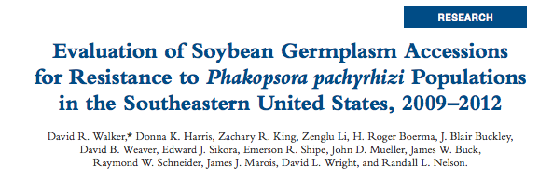
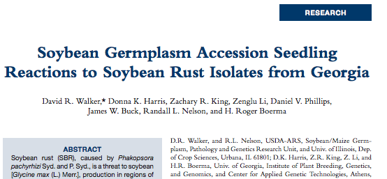
Recent Rust Publications

Slide 38
Fighting Rusty Beans with MAS
New DNA extraction protocol
Validation of new protocol
Application in high-throughput genotyping

Slide 39
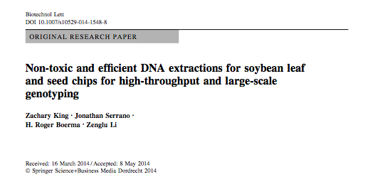
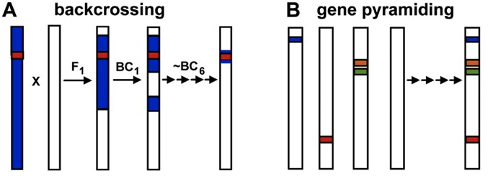
Modified DNA Extraction
Backcrossing
Gene pyramiding

Slide 40
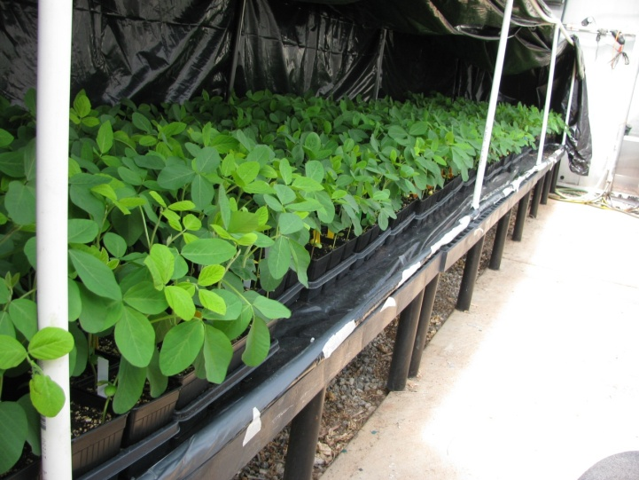
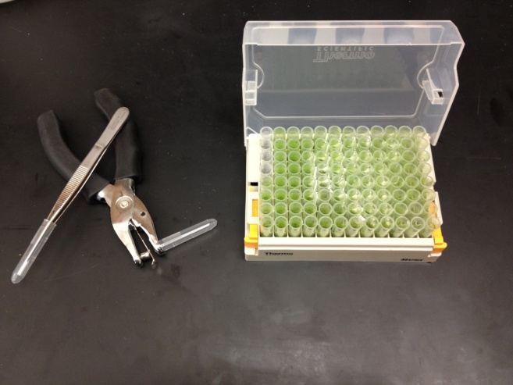
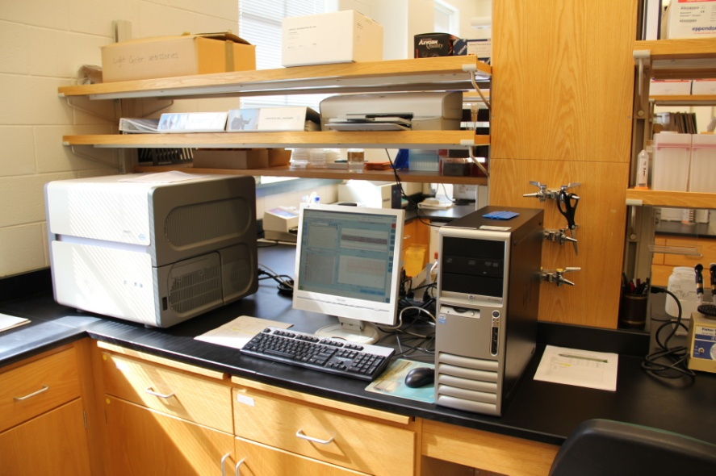
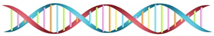
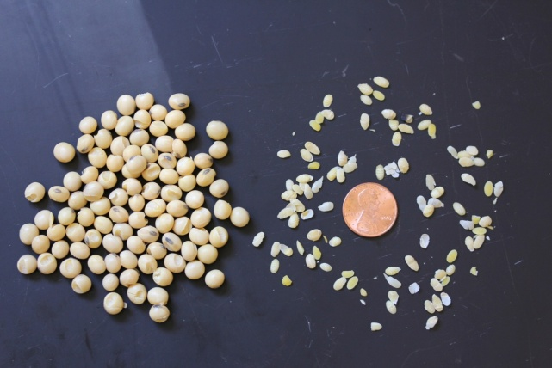
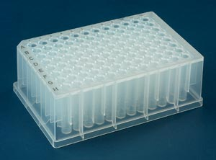
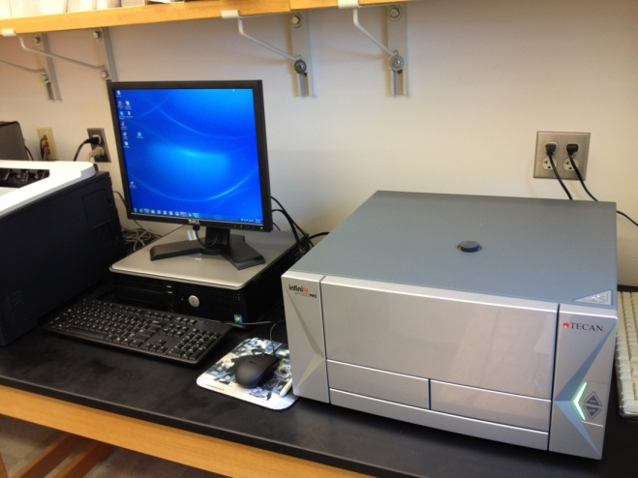
SNP Genotyping Workflow
Plant tissue
SimpleProbe genotyping
Roche
Extracted DNA
Or
Seed chips
KASPar genotyping
KBioscience

Slide 41
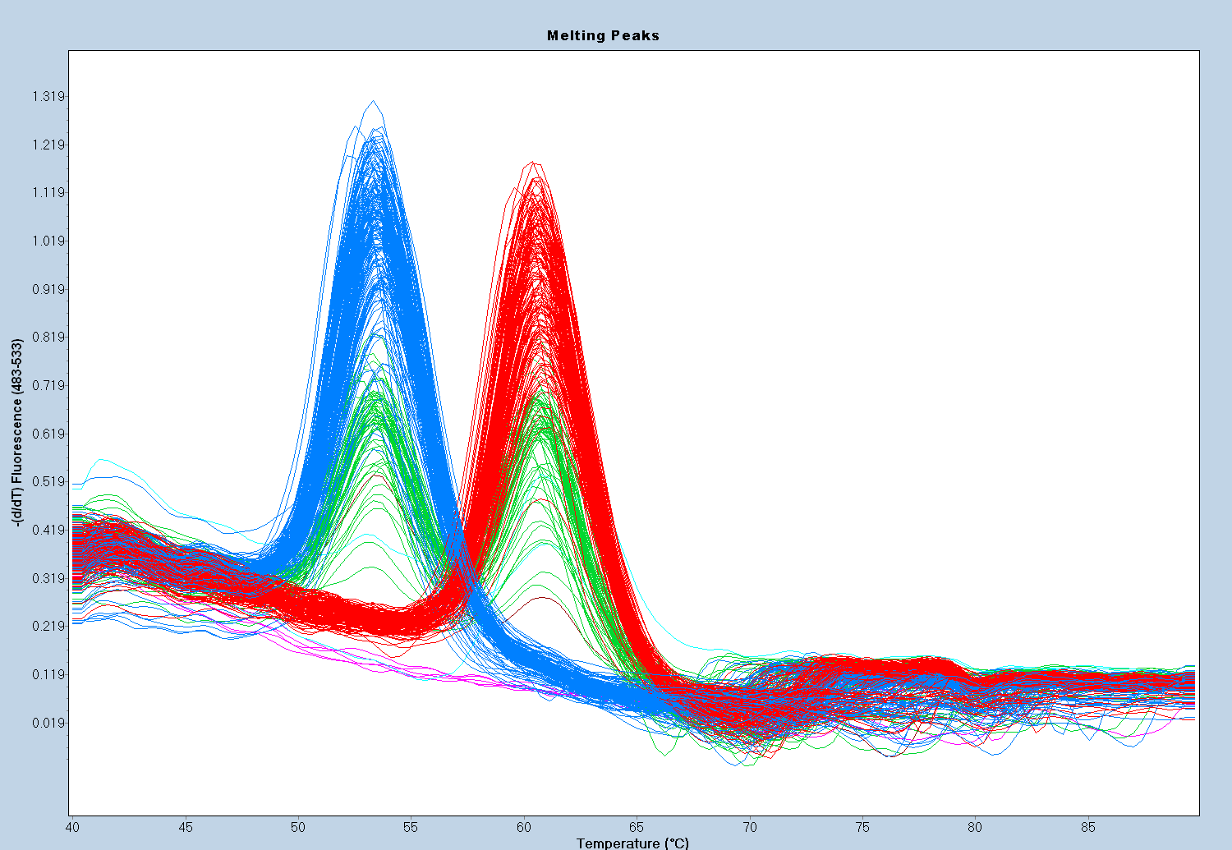
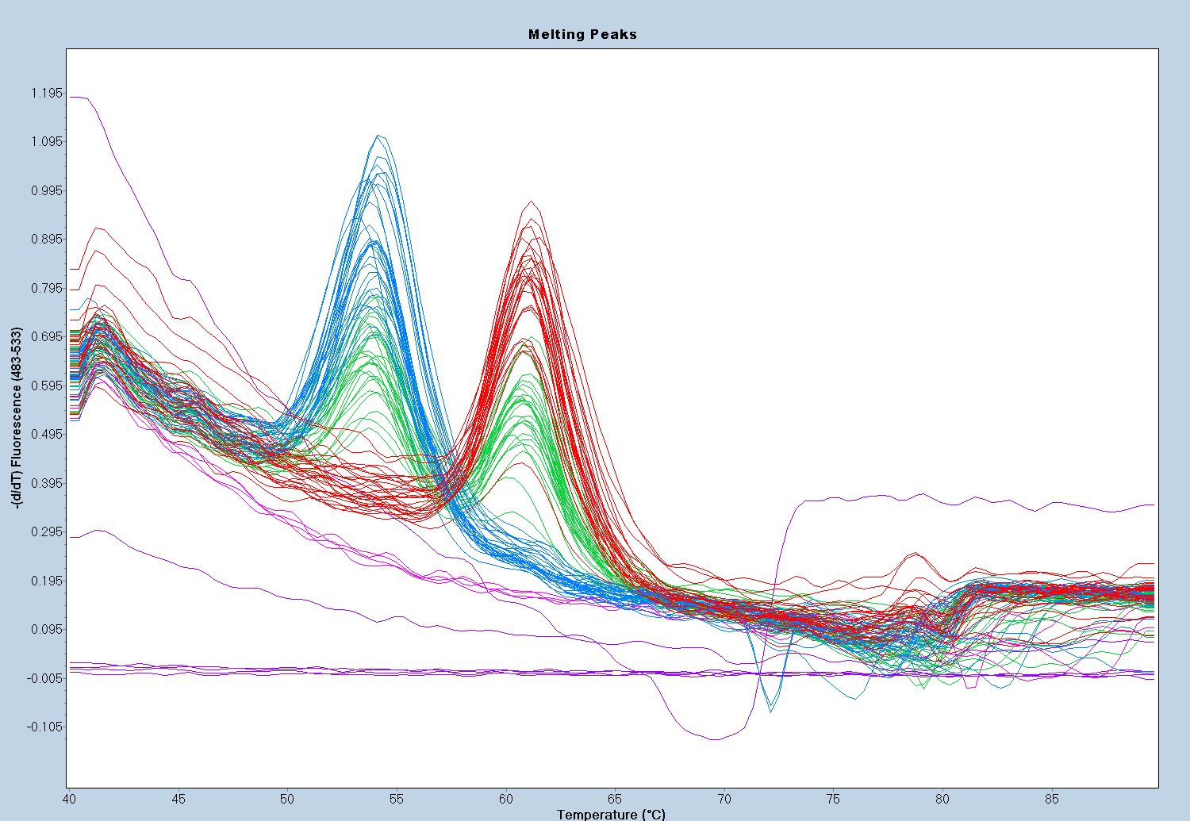
A
[G]
B
[G]
[T]
[T]
^{SNP06-44058 PCR reactions} ^{for the detection of Rpp3}
Notes:
Font size 12
1500 size
Save as PDF in PowerPoint 8.5x11 in
Open PDF in Photoshop
Save PDF as TIFF (Select LZW compression, No Layers)

Slide 42


A
B
[G]
[C]
HEX Dye Intensity
HEX Dye Intensity
[A/G]
[T]
[A]
FAM Dye Intensity
FAM Dye Intensity
SNP genotyping results using the high-throughput DNA extraction method for markers SAPCD-C ^{and GSM0040}

Slide 43






High-Throughput DNA Extraction from Leaf and Seeds

Slide 44
Acknowledgements
Roger Boerma
Zenglu Li
Donna Harris
Tatyana Nienow
Jonathan Serrano
Kurk Lance
David Walker (USDA) – Collaboration and Phenotyping
James Buck’s Lab (UGA) – Phenotyping
Scott Jackson (UGA) – Collaboration
Kerry Pedley’s Lab and Mandy Kendrick (USDA) - Phenotyping
Daniel Phillips (UGA) - Phenotyping
Perry Cregan’s Lab (USDA) – Infinium Chips and fingerprinting
Dechun Wang’s Lab (MSU) - Infinium Chips’ fingerprinting
David Spradlin, Dick Miller, and Brian Vermeer
The Seed Lab Team: Gina Bishop, Dale Wood, Earl Baxter, Briceson Wilson, Sarah Stone, and Thorne Wilson
The University of Georgia®
Institute of Plant Breeding, Genetics & Genomics

Slide 45


Now… Let’s Transition to the #1 Crop!
Corn breeding in Minnesota
My goal is to be part of Monsanto’s powerful future, based on my strong past
Utilize my strengths
Inbred development
Monsanto experience
Apply knowledge to corn breeding
monsanto.com
Notes:
5% Refuge in the bag
RoundUp Liberty Link
Two forms of insect resistance

Slide 46


Minnesota is 4th Largest Corn Producing State (2014)
~7.8 million acres harvested in 2014
agweb.com/corn-harvest-map/
USDA data from 2010
usda.gov/nass/PUBS/TODAYRPT/crop1014.pdf
Notes:
Iowa, Illinois, Nebraska, Minnesota– grow about half of all the corn in the U.S.

Slide 47

Genetic Gain of Corn
Genetic gain in the US
OP, double cross hybrids, single cross hybrids, and biotechnology traits
~1.9 bushels/acre/year
Breeding technologies driving genetic gain
USDA-NASS. 2012. Crop Production: agry.purdue.edu
Notes:
Two Ways To Control Corn Rootworm And Corn Earworm.
SmartStax® RIB Complete® offers two built in modes of action that can deliver maximum control of both corn rootworm and corn earworm.

Slide 48
Double Haploids to Increase the Rate of Genetic Gain
Double haploid production
Haploids induced and identified by pigmented scutellum and unpigmented aleurone
Chromosome number restored with colchicine
Time savings for inbreds and genetic gain increases
Scutellum
Aleurone
Haploid
Haploid w/ ligule
Melchinger et al., 2013: Nature Scientific Reports

Slide 49
Genomic Selection-A Valuable Tool for Corn Breeding
Large data sets available
Phenotypic information over environments
Genomic information
Pedigree information or kinship
GS helps breeders make decisions
Combining tools
Double haploids and GS
Predict hybrid performance
Selected populations
Genotyping & Phenotyping
Reference populations
Genomic Selection Model
Breeding Materials
Genotyping data
Calculate Estimated Breeding Value
Make selection
Massman et al, 2012: Crop Science
Modified from Wong and Bernardo, 2008

Slide 50


Corn Breeding Many Tools for a Bright Future
Many other tools
Winter nursery
Disease screens/pathology
Diverse germplasm
Seed chipping platform
Diverse test sites
Key biotechnology traits
Planting and harvest technologies
Development of innovative breeding techniques utilizing modern databases
nationalgeographic.com
monsanto.com

